Slide 1
Servus
1
Python Intermediate – Spring 2025 Topic: Virtual Environments

Slide 2
Ask, ask, ask!
If:
you have a Python related problem...
something is not working…
you don’t understand an exercise...
you need help somehow...
Then:
write your question in our Slack channel, maybe someone else had the same issue and can help you
write a colleague on Slack
write a teacher on Slack
note it down and ask next class
...just don’t let it block you!

Slide 3
Revision: Packages

Slide 4
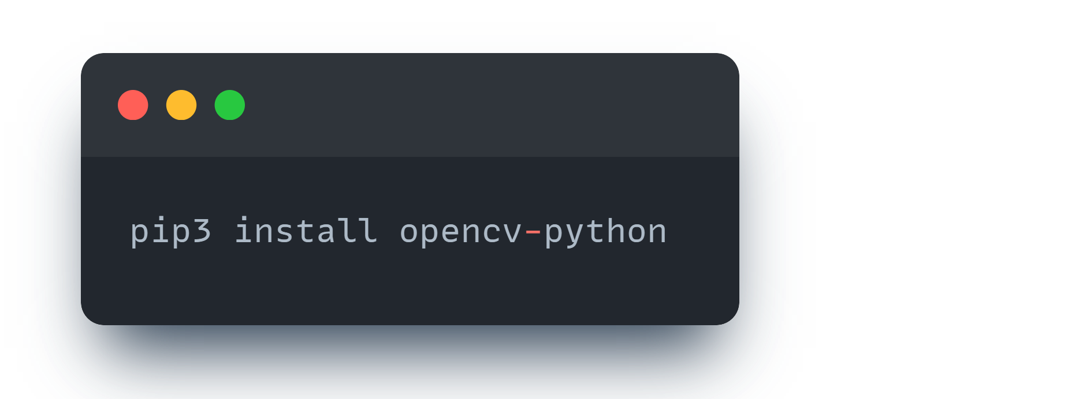
Packages
Packages are a quick and easy way to use code that someone else already did (for example, open source code)
If I want to use some Computer Vision code in my project, I don’t need to write code to process the image information, as someone already did that for me: I can use the OpenCV library -> https://opencv.org/get-started/

Slide 5
Demo: sharing projects!

Slide 6
Virtual Environments

Slide 7
Virtual Environments
Virtual environments are an easy way to test our project as if we were in a new computer
That way we can isolate all our dependencies in our project so when we share it with other people, we know it will work in their computer as well
The most common phrase a software developer says (and also the most annoying!) is “It works on my machine!”

Slide 8
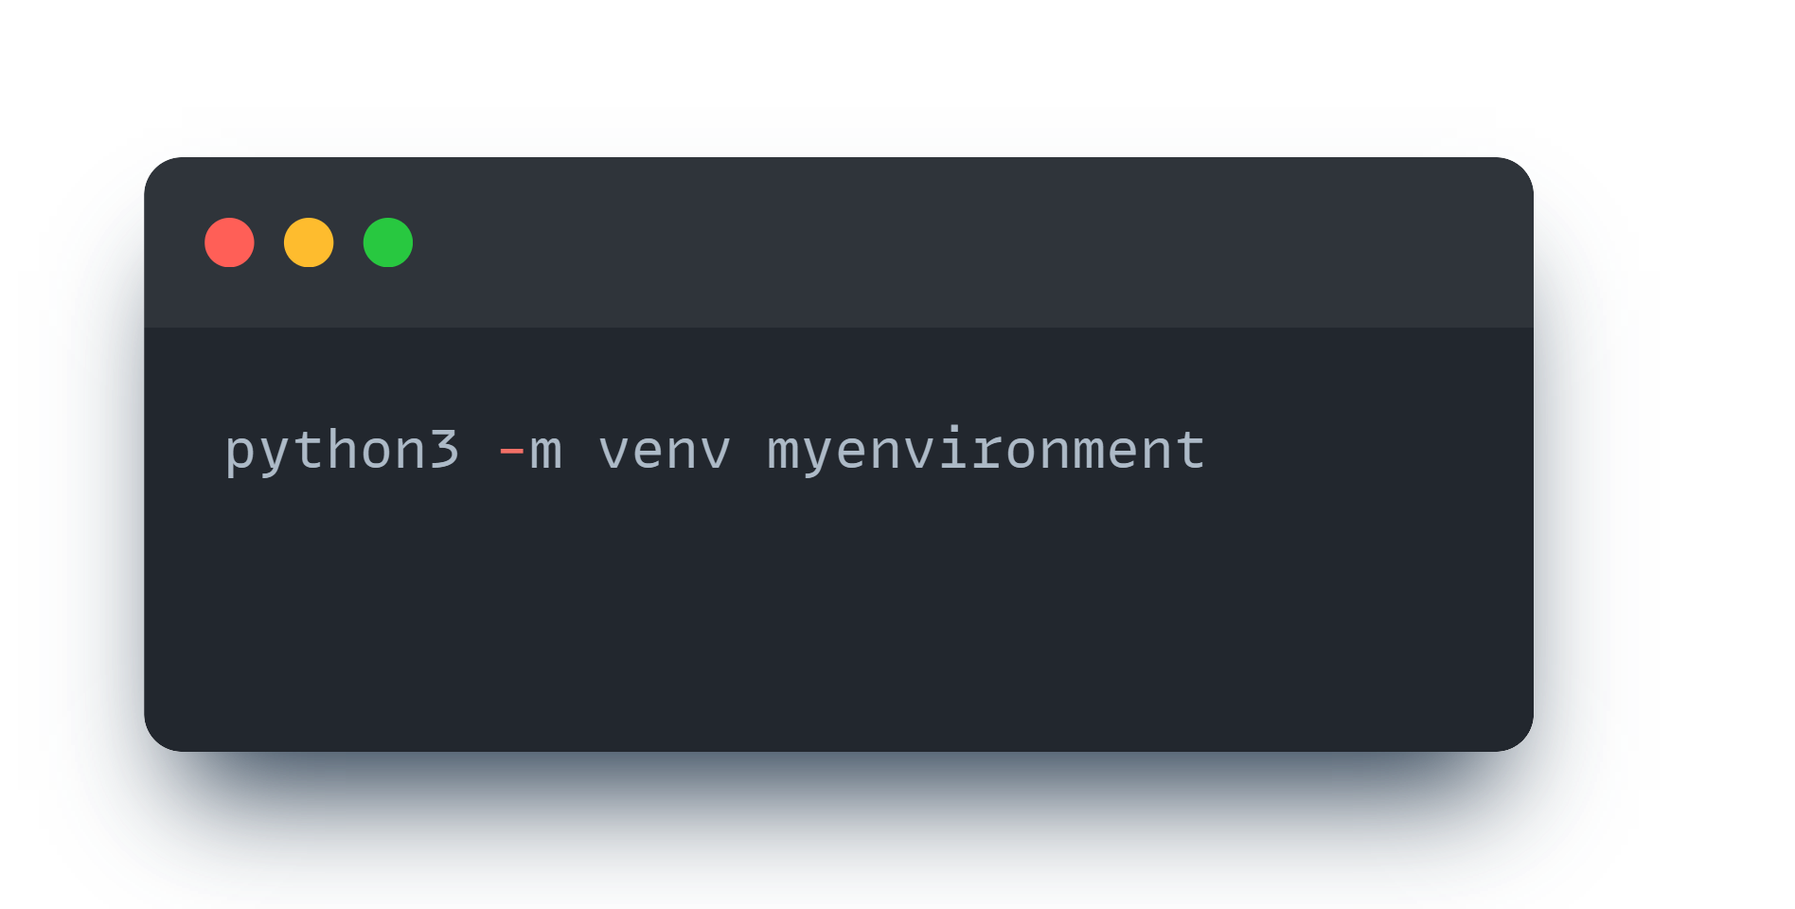
How to create a virtual environment

Slide 9
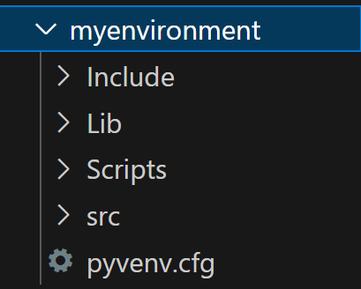
This creates a new folder with the name we provided, where our “environment” lives!
Let’s create another folder, “src” where we keep all our .py files!

Slide 10
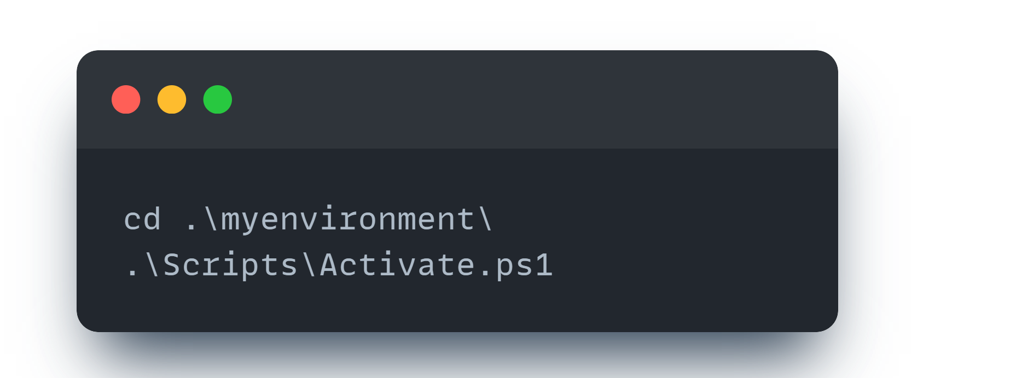
Now that we created our environment, we need to activate it! No point in just creating it…

Slide 11
While you are “inside” the activated environment, you can install packages. These packages will be installed in your environment (AND NOT ON YOUR COMPUTER – so they will not work once you deactivate your environment)

Slide 12
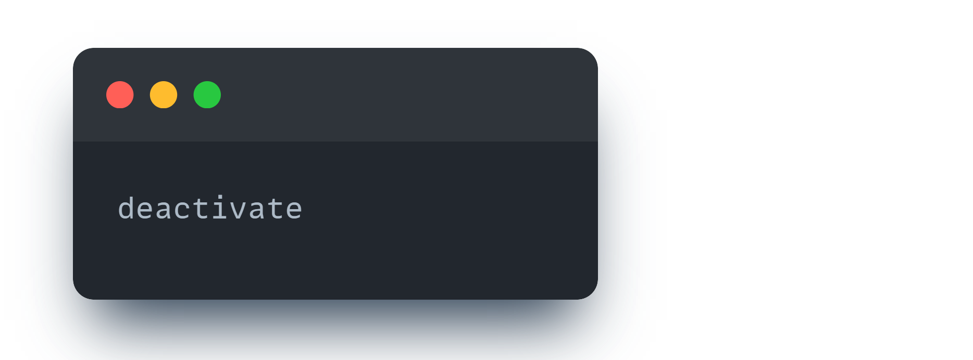
When you are done working on that project, you should deactivate your environment.
Then, you are free to go to work on other projects, activate the environment for the other project, etc etc

Slide 13
requirements.txt

Slide 14
Okay, so this is all so we can easily share our projects with other people, but how do we do that????
I want to contribute to this project in my computer, a famous open source project on GitHub to use http requests more easily: https://github.com/psf/requests
I hope they can tell me which libraries I need to install in my virtual environment…

Slide 15
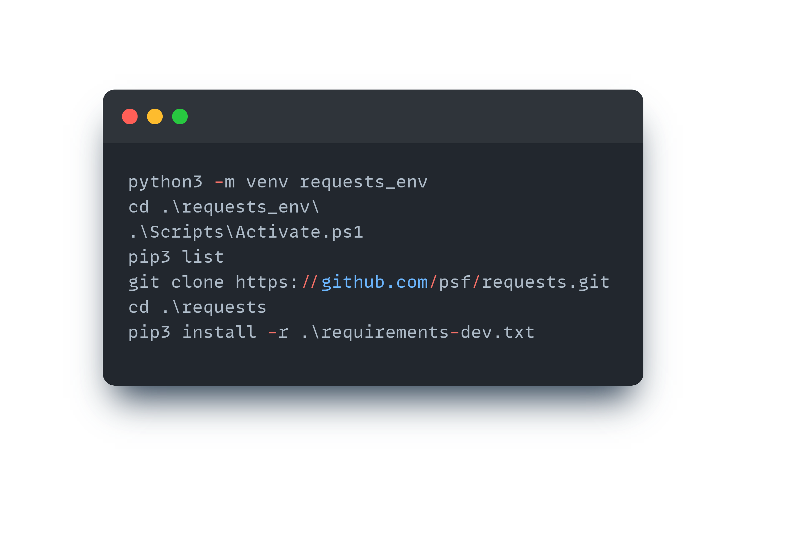
Okay, so this is all so we can easily share our projects with other people, but how do we do that????
I want to contribute to this project in my computer, a famous open source project on GitHub to use http requests more easily: https://github.com/psf/requests
I hope they can tell me which libraries I need to install in my virtual environment…

Slide 16
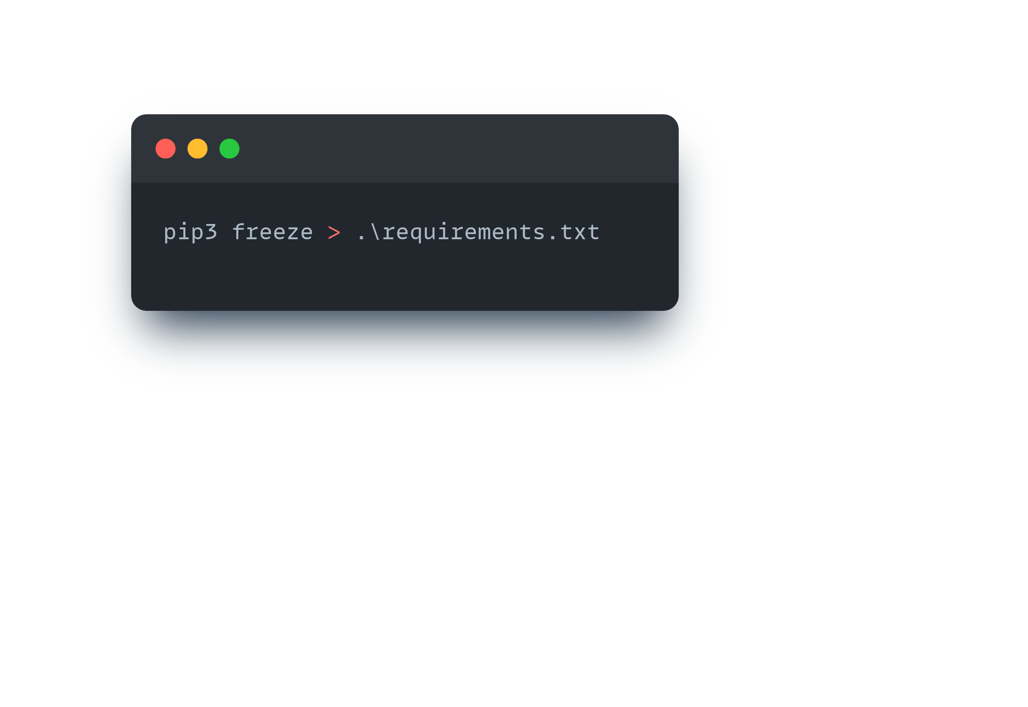
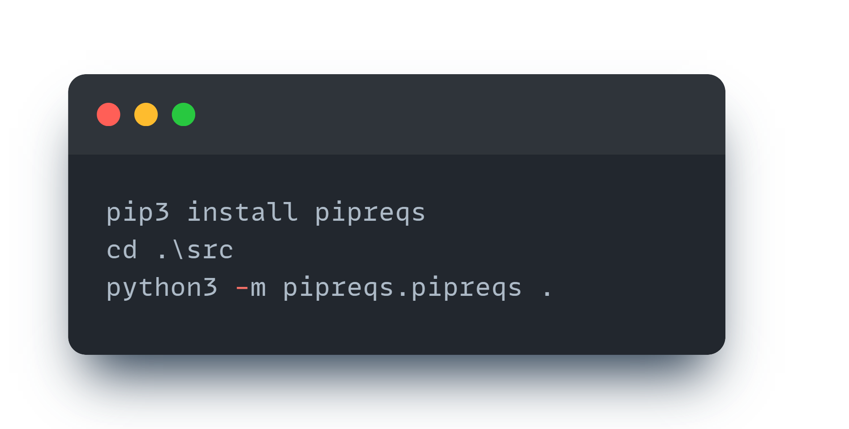
How to generate a requirements.txt file for my own project?
freeze -> good (gets a list of all the packages installed in the current virtual environment)
pipreqs -> better! (gets a list of all the packages used in the code)
Only need to install it the first time (first time in each virtual environment!)
Since pipreqs scans your code, it is important to run it only on the src folder (a folder with only your .py files!)

Slide 17
What to upload to github?
When sharing your projects, you don’t need to (and shouldn’t) upload the entire virtual environment to github…
Inside your virtual environment should be your src folder (or a different name) which should be where your github repo
Don’t forget: the requirements.txt should be in the root folder of the project

Slide 18
README.md
The most important file of any project: the README
This file usually contains a short summary of the project, how to get the requirements, how to run it, etc
Let’s look at an open source project README: https://github.com/ageitgey/face_recognition
.md are Markdown files: these files have special ways to format, for example:
# My Project (title)
## How to get the requirements for my code
You should do this:
```
pip3 install –r requirements
```
Add titles with #, subtitles with ##, and smaller and smaller with ###, etc
Add code snippets between ```

Slide 19
Exercises

Slide 20
Using venv
Create a virtual environment for your project -> choose a name that identifies it!
Go into the environment with cd, and activate it

Slide 21
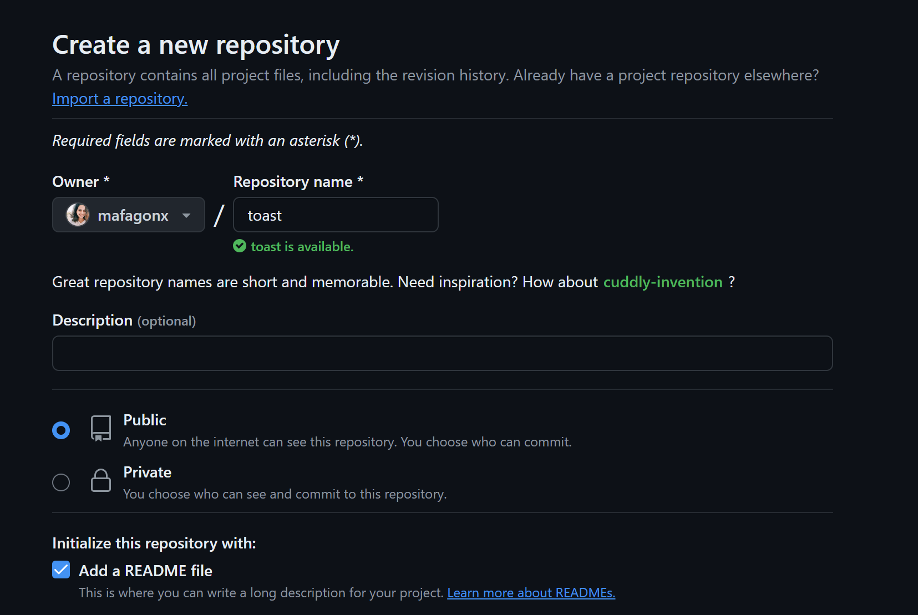
Using GIT
Create a git repo in github.com -> you can add README file already

Slide 22
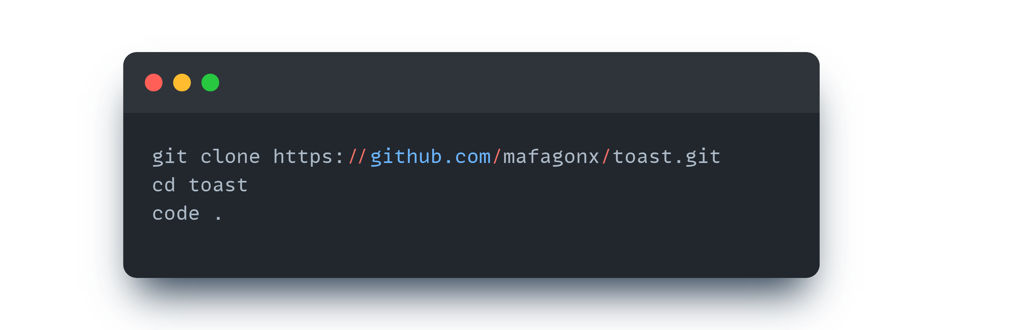
Using GIT
Clone your new git repo into your current folder (inside your environment)
Go into the folder and open VSCode

Slide 23
Testing project
Get the file toast.py from Google Classroom
Test the file: it shouldn’t work
Install the missing packages (win10toast) on the environment and test it: it should work
PACKAGE-NAME

Slide 24
Creating requirements file
Create a requirements.txt file

Slide 25
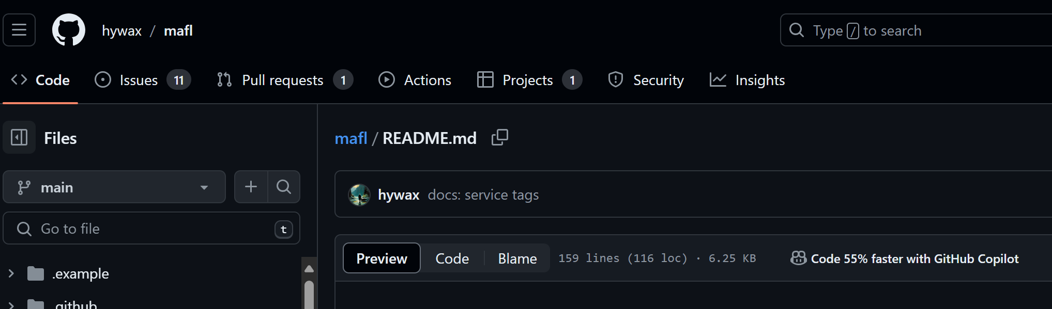
Writing a good README
Your readme should include a good description of the project, how to clone and install the requirements, and how to run the project
If you have multiple files and folders, you should add a small explanation for these
Google examples of README files, see https://github.com/hywax/mafl#readme
In github, if you open a README.md, toggle between Preview and Code to see how to write cool stuff in Markdown
You can add screenshots of the program running, etc etc etc
How to markdown: https://www.markdownguide.org/cheat-sheet/

Slide 26
Done!
Commit and push the file, requirements.txt and README of your project
Share your repo with the teachers!!
Hopefully, you can use this exercise as a guide on how to share your final project ;)
Relevant links:
Virtual envs: https://python.land/virtual-environments/virtualenv
requirements.txt file: https://frankcorso.dev/setting-up-python-environment-venv-requirements.html
Markdown files: https://www.markdownguide.org/cheat-sheet/
How to use github: https://www.youtube.com/watch?v=r8jQ9hVA2qs&t

Slide 27
27
Thank you for your attention!

